Slide 1

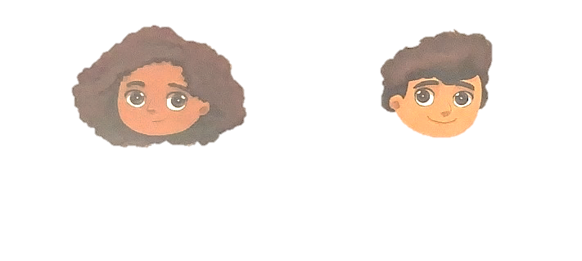

2
raise your hand
1

